Slide 1
Moving Forward With Palmetto GBA Nashville MGMA October 9, 2018
Paula Motes
Senior Clinical Education Consultant
Provider Outreach and Education
The information in this presentation is confidential and considered proprietary to Palmetto GBA.

Slide 2
Disclaimer
The information provided in this presentation was current as of 10/5/2018.
Any changes or new information superseding the information in this presentation is provided in articles with publication dates after 10/5/2018, posted on our website at:
www.PalmettoGBA.com/JJB
CPT only copyright 2018 American Medical Association.
All rights reserved.
The Code on Dental Procedures and Nomenclature is published in Current Dental Terminology (CDT), Copyright © 2018 American Dental Association (ADA). All rights reserved.

Slide 3
Agenda
Updates and Reminders
Targeted Probe and Educate
Comprehensive Error Rate Testing Program
Documentation and Compliance
Utilizing Palmetto GBA Resources

Slide 4
Updates and Reminders

Slide 5
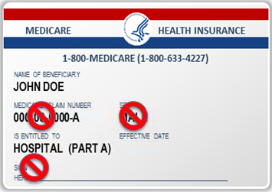
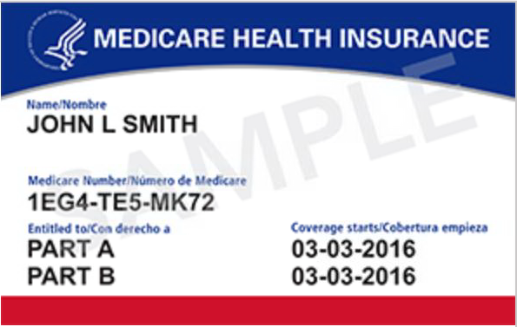
New Medicare Card
By April 2019 MACRA requires the removal of SSNs from all Medicare cards
The number zero (0) will be used but the alpha characters S, L, O, I, B, Z will not be used

Slide 6
Obtaining New MBIs
Beginning October 2018, through the transition period, when you submit a claim using your patient’s valid and active HICN, we will return both the HICN and the MBI on every remittance advice
The MBI will be in the same place you currently get the “current HICN”
You are now able to look up your Medicare patient’s new MBI through the Palmetto GBA’s eServices portal (currently only available for patients that have received their new card)
Sign up for eServices NOW!

Slide 7
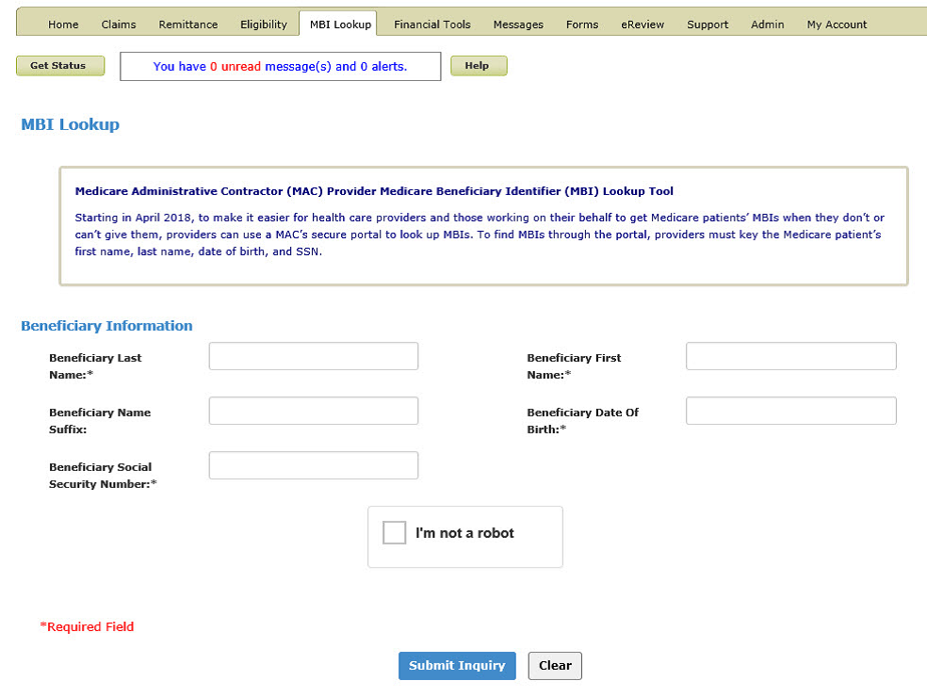
Medicare Beneficiary Identifier (MBI) Look-Up Tool

Slide 8
Medicare Beneficiary Identifier (MBI) Successful Response
If the inquiry successfully returns an MBI, the screen will refresh with the data at the bottom

Slide 9
Medicare Beneficiary Identifier (MBI) Unsuccessful Response

Slide 10
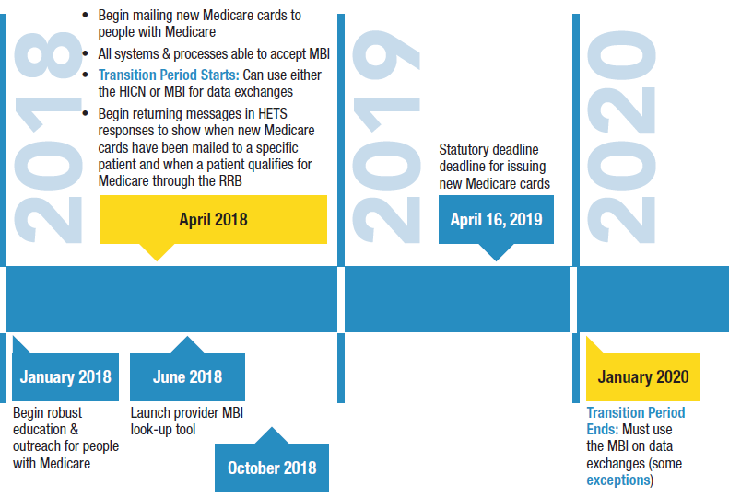
MBI Generation and Transition Period

Slide 11
MM 10875
Quarterly Update for Clinical Laboratory Fee Schedule and Laboratory Services Subject to Reasonable Charge
Payment effective date: 10/1/18
Implementation date: 10/1/18
MLN 10875 provides instructions for the quarterly update to the Clinical Laboratory Fee Schedule (CLFS)
Some codes added and will be contractor-priced, until they are addressed at the annual Clinical Laboratory Public Meeting
Reminder - effective January 1, 2018, CLFS rates are based on weighted median private payer rates as required by the Protecting Access to Medicare Act (PAMA) of 2014

Slide 12
MM 10852
October Quarterly Update to 2018 Annual Update of HCPCS Codes Used for Skilled Nursing Facility (SNF) Consolidated Billing (CB) Enforcement
Effective date: 1/1/16
Implementation date: 10/1/18
Provides updates to the lists of HCPCS codes that are subject to the CB provision of the SNF PPS
MACs will reopen claims brought to their attention

Slide 13
MM 10819
17 New Clinical Laboratory Improvement Amendments of 1988 (CLIA) waived tests approved by the Food and Drug Administration (FDA)
Effective dates listed in the MLN
MACs will not search their files to either retract payment or retroactively pay claims. However, they will adjust claims if they are brought to their attention

Slide 14
MM 10827
Quarterly Update to the National Correct Coding Initiative (NCCI) Procedure to Procedure Editing
Effective 10/1/18

Slide 15
MM 10627
Medical Review of Evaluation and Management E/M Documentation
Effective and Implementation date: 8/14/18
Provides direction to Medicare’s medical review contractors on how to review claims where a medical student documented the E/M service.
This is a follow-up instruction to CR10412 (published in February 2018), which allowed teaching physicians to verify a student’s E/M visit notes rather than re-documenting them.
The “Medicare Claims Processing Manual”, Chapter 12, Section 100.1.1 (B) states the teaching physician must personally perform (or re-perform) the physical exam and medical decision making activities of the E/M service being billed, but may verify any student documentation of them in the medical record rather than re-documenting this work. If the teaching physician chooses to rely on the medical student documentation and chooses not to re-document the E/M services, contractors shall consider this requirement met if the teaching physician signs and dates the medical student’s entry in the medical record.”

Slide 16
MM 10845
MM 10845 - Certification Statement & Fee Payment Policy Changes
MACs shall begin processing ALL applications upon receipt and shall develop for missing certification statements and all other missing information, including application fee, upon review
Will NO LONGER request the fee payment outside of the normal development process
Providers have 30 days to respond to the development request to include paying the fee
Submission of a paper certification statement via the mail is no longer accepted. The provider MUST UPLOAD IN PECOS if not using eSignature process

Slide 17
MM 10457
CMS has established a new physician specialty code for Medical Genetics and Genomics (D3)
Effective Date: October 1, 2018
Implementation Date: October 1, 2018

Slide 18
Split Post-Op Care
Modifier 54 – surgical care only (submit this modifier when one physician performs a surgical procedure and another provides preoperative and/or postoperative management)
Modifier 55 – postoperative management only (use this modifier to indicate that payment for the postoperative care is split between two or more physicians where the physicians agree on the transfer of postoperative care)
Physicians performing surgery and providing partial follow up (post-operative) care during the global period of a surgery must submit the claim with at least the following detail lines:
Submit the surgery with CPT modifier 54 (surgical care only) on one detail line
On a separate detail line submit the surgery date as the date of service, the surgery code with CPT modifier 55 (postoperative management only) and the number of postoperative days the patient was under the surgeon's care
Related Palmetto GBA website articles:
Split Post-Op Care and the Global Surgery Package
https://www.palmettogba.com/palmetto/providers.nsf/DocsR/JJ-Part-B~8EELE21366
CPT Modifier 54
https://www.palmettogba.com/palmetto/providers.nsf/DocsR/JJ-Part-B~8EEL972728
CPT Modifier 55
https://www.palmettogba.com/palmetto/providers.nsf/DocsR/JJ-Part-B~8EELFA8540

Slide 19
MolDX® Molecular Diagnostic (MolDX) Program
The MolDX® program was implemented in Jurisdiction J on July 1, 2018
For more information, visit our MolDX page
Covered tests
Excluded tests
FAQs
MolDX® Local Coverage Determinations (LCDs)

Slide 20
MolDX®
Providers are required to register all molecular tests with the Diagnostics ExchangeTM (DEX), an online test registry
DEX Diagnostics ExchangeTM will assign a unique Z-Code identifier to each molecular test
After the registration and application processes have been completed, the MolDX team will access the registry information to determine if a test meets the Medicare criteria for coverage

Slide 21
Medicare Covered Preventive/Screening Services
Preventive services educational tool
https://www.cms.gov/Medicare/Prevention/PrevntionGenInfo/Downloads/MPS_QuickReferenceChart_1.pdf
Peventive services poster for your office
https://www.cms.gov/Outreach-and-Education/Medicare-Learning-Network-MLN/MLNProducts/Downloads/PreventiveServicesPoster.pdf

Slide 22
Home Health Certifications
Require documentation of a face-to-face encounter
Certifying physician is required to certify (attest) that a face-to-face patient encounter occurred and document the date of the encounter as part of the certification of eligibility
Documentation must be in the certifying physician’s medical records and/or the acute/post-acute care facility’s medical records (if the patient was directly admitted to home health) to be used as the basis for certification of patient eligibility
MM9119

Slide 23
TPE, CERT and Documentation Compliance

Slide 24
Medical Review
The goal of the medical review program is to reduce payment errors by identifying and addressing billing errors made by providers concerning coverage and coding
To achieve the goal of the medical review program, Palmetto GBA:
Proactively identifies patterns of potential billing errors concerning Medicare coverage and coding made by providers through data analysis and evaluation of other information (e.g. complaints)
Reviews data analysis reports
Takes action to prevent and/or address the identified error

Slide 25
MR Top Denials Jurisdiction J

Slide 26
Targeted Probe and Educate
TPE = Targeted Probe and Educate
MAC conducts data analysis to identify areas with the greatest risk of inappropriate program payment
CMS may also identify areas of risk and direct MAC to review
Provider are selected for review based on data analysis
Provider specific only
Eliminates service-specific reviews

Slide 27
TPE Process
Up to three rounds of probe review
Each round consists of a 20-40 claims for review
One on one education intervention with clinical staff
Allows 45-56 days between education intervention and next round
Review may be discontinued when the provider becomes compliant
Monitor for one year via data analysis with follow-up review if needed

Slide 28
TPE Process
Conduct data analysis of billing data indicating aberrancies that may suggest questionable billing practices
Jurisdiction J Reviews
99232-99233
99291-99292
A0426/A0428/A042
May include providers previously reviewed on a targeted or service-specific review with high error rate
Notification letters are mailed to providers selected for review

Slide 29
TPE Process
Additional Document Request (ADR) generated for each claim selected
Recommend using eServices to submit documentation in response to medical review ADRs and any additional documentation request throughout the review process
Prior to the conclusion of each round providers with moderate to high error rate will receive a telephone call to discuss the summary of the errors found

Slide 30
TPE Process
After each round a review results letter is mailed and will include the number of claims reviewed, the number of claims allowed in full, and the number of claims denied in full or in part
When high denial rates continue after three rounds of TPE, Palmetto GBA will send a referral to CMS for additional action

Slide 31
TPE
It is imperative when responding to the TPE ADR that you include the name and number of your designated contact person
The medical reviewer will contact your designated person to discuss a pattern discovered during the review and/or prior to the conclusion of each TPE round to discuss the review summary

Slide 32
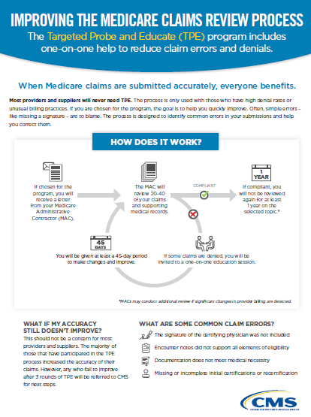
CMS Targeted Probe and Educate
Palmetto GBA has resources under ‘Medical Review’ the Palmetto GBA webpage

Slide 33
Documentation – It’s Important!
Golden Rules of Documentation
Not documented = Not Done
Paid for what you document!
Document! Document! Document!
Less is not more. More is Better!

Slide 34
Comprehensive Error Rate Testing (CERT) Program
Established by the Centers for Medicare & Medicaid Services (CMS) to determine improper payment rates
Utilizes a statistically valid random sample of paid claims
Claims reviewed utilizing Medicare coverage, coding, and billing rules

Slide 35
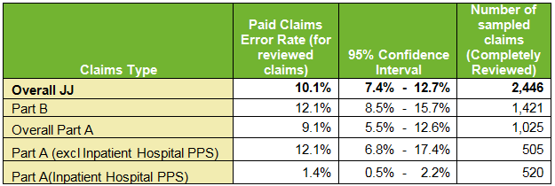
Jurisdiction J Comprehensive Rate Testing (CERT) Error Rate
JJ CERT Error Rate November 2017 Report

Slide 36
Jurisdiction J Part B Problem List
JJ Part B Problem List 2017
Diagnostic Services: Clinical Labs
99214/99215 - Established Patient Office Visits
99232/99233 - Subsequent Hospital Care
A0426/A0428 - Ambulance Services (Non-Emergent); A0427/A0429 - Ambulance Services (Emergent)
66984 - Extracapsular Cataract Removal with Insertion
J0178 - Aflibercept Injection
99291/99292 - Critical Care
90960-90963 - ESRD - Outpatient Monthly
93306 - Echocardiography with Contrast

Slide 37
Drugs and Biologicals

Slide 38
Drugs and Biological Errors
Documentation submitted:
Did not support medical necessity of drug and/or dose administered
For wrong patient
For incorrect dates of service
Did not include a signed order or documentation to support intent to order the drug
Did not indicate drug administration protocol was followed;
Did not submit the service(s) billed
No documentation of administration of the drug billed
Did not support the number of units billed

Slide 39
Tips to Avoid Errors
Include the history that supports the need of the drug
Documentation should support the diagnosis of why the patient is receiving the drug
Make sure documentation it’s for the right patient and the right date of service
Check for signed and dated physician’s order
Follow the protocol when administering the drug
Document the drug name, dosage and method of administration
Bill the correct number of units based on HCPCS code and amount administered

Slide 40
Laboratory and Diagnostic Service CERT Errors
The majority of improper payments for laboratory services - insufficient documentation
Insufficient documentation means that something was missing from the medical records

Slide 41
Diagnostic Service Documentation Tips
The physician who is treating the beneficiary must order all diagnostic X-ray tests, diagnostic laboratory tests, and other diagnostic tests
The physician who treats the beneficiary is the physician who furnishes a consultation, treats a beneficiary for a specific medical problem, and uses the results in the management of the beneficiary’s specific medical problem
Tests not ordered by the physician are not reasonable and necessary

Slide 42
Diagnostic Test Documentation Tips
Respond to every medical record request
Include progress notes or office notes that support the order and medical necessity of each test
Physician order/intent to order
Laboratory/test results or report
Check for signatures

Slide 43
Signature Requirements
Unsigned physician orders or unsigned requisitions alone do not support physician intent to order
Physicians should sign all orders for diagnostic services to avoid potential denials

Slide 44
Signature Requirements
If the signature is missing on a progress note which supports intent, the ordering physician must complete an attestation statement and submit it with the response
Visit the CERT Provider website or Palmetto GBA website for an example of a attestation statement
If the signature is illegible, an attestation statement or signature log is acceptable
Attestation statements are not acceptable for unsigned physician orders/requisitions

Slide 45
Billing Provider
If you bill laboratory or other diagnostic services to Medicare:
You must obtain the treating physician’s signed order (or progress note to support intent to order); and
Documentation to support medical necessity for the ordered service(s)
Special Note: These records may be housed at another practitioner’s office or facility (for example, a nursing facility, hospital, or referring physician)

Slide 46
Ordering Provider
If you order diagnostic services for Medicare patients you must also maintain documentation of the order/intent to order and medical necessity of the service(s) in the patient’s medical record.
Keep this information available and submit it, along with the test results, upon request for a Medicare claim review.
Cooperation among ordering/referring providers and facilities that perform diagnostic tests is crucial to reducing errors and avoiding claim denials.
MM9112

Slide 47
Error Reduction
Errors require maintenance
In order to have successful paid claims, providers must conduct maintenance
Self audits will decrease the common “error” threads that weave through the system causing a disconnect between claim submission and claim payment

Slide 48
Your Proactive Approach
Use a tracking system for ALL medical record requests
Log each request and note the due date
Review the request, pull the records
Use lists available on the Palmetto GBA website
Review the records and authentication
Do the records support each service billed?
If records are for a diagnostic service you must include:
Signed order for the services along with documentation of the medical necessity for each test
Test results
Document the log when the documentation was submitted along with what documentation was submitted

Slide 49
Check and Double Check!
Submit medical records that are:
For the right beneficiary
Right date of service
Complete documentation for every service
Right order(or intent to order) for the patient
Support medical necessity for each service

Slide 50
CERT and Medical Review Tips…
Remember, it is the billing provider’s responsibility to obtain any necessary information required for the record review, regardless of the location of the documentation
Ensure the documentation has legible signatures and dates
Ensure physician orders and documents the interventions performed
Include test results and lab results if applicable
Make sure the copy sent to the review contractor is legible
Number the pages before making a copy, so it will be easy to see if one of the pages are missing

Slide 51
Appeal Your CERT Errors!!!
If you receive a CERT error”
Review the error
Review the submitted documentation
Appeal the denial and include any additional information that supports payment of the claim!

Slide 52
Utilizing Palmetto GBA Resources

Slide 53
Palmetto GBA Website www.PalmettoGBA.com/JJB

Slide 54
Palmetto GBA Website

Slide 55
Palmetto GBA eServices
Our preferred mechanism for interacting with Palmetto GBA to:
Check Eligibility
Claims Status
Respond to Additional Documentation Requests
Submit First Level Redeterminations and Reopening Requests
Submit eChecks or eOffset for overpayments

Slide 56
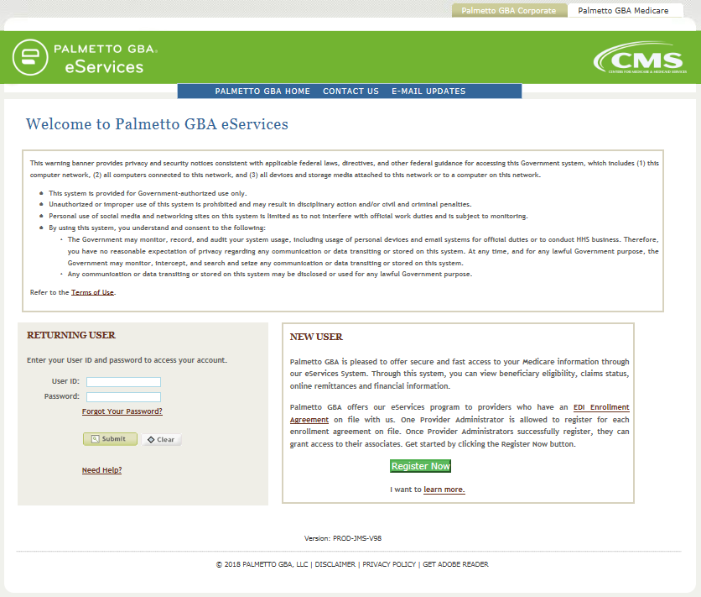
Palmetto GBA eServices Registration
https://palmettogba.com/eservices

Slide 57
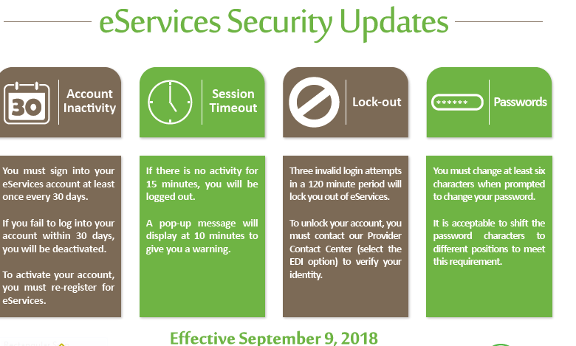
eServices: Security Changes

Slide 58
MSP Lookup
MSP Lookup Tool

Slide 59
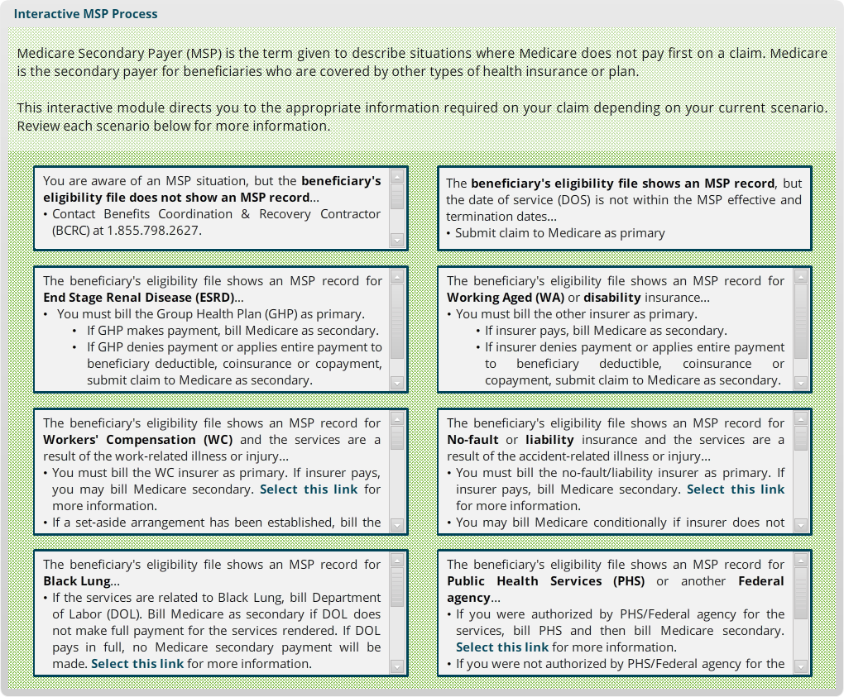
Interactive MSP Process

Slide 60
Palmetto GBA Listserv E-Mail Updates
Get automatic email updates from Palmetto GBA
Listserv messages keep you updated with the latest information from CMS and Palmetto GBA:
Policy changes
LCD updates
Educational opportunities
Claims Processing and Payment Issues (CPIL)
**Select ‘Listservs’ from the top-right navigation bar on the Palmetto GBA homepage

Slide 61
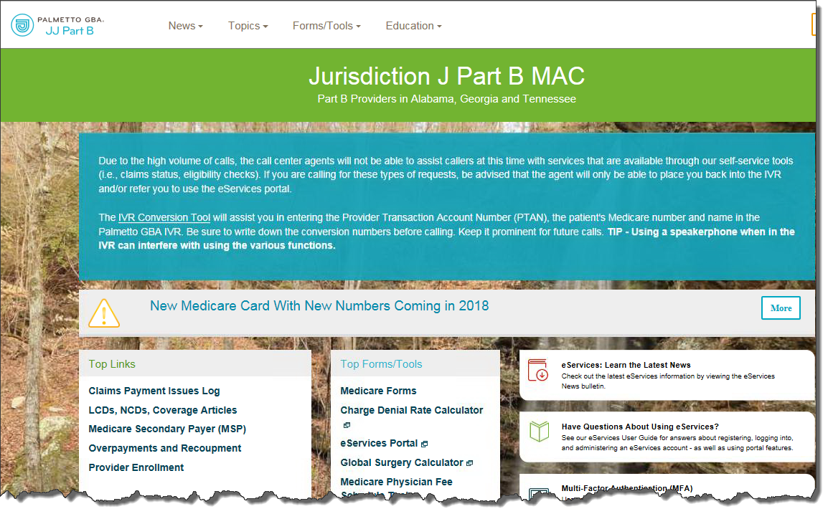
Claim Payment Issue Log (CPIL)
CPIL articles listed in bold font are JJ only CPILs.
Claims Rejected in Error for MolDX Services
Claims for Certain Services in a SNF Denied in Error
Claims Denials of Certain Anesthesia Codes when Performed in Place of Service (POS) 11
HCPCs Q5105 and Q5106
Incorrect Denials Indicating Skilled Nursing Facility (SNF) Consolidated Billing (Includes Ambulance Services)
Claims Paid After a Provider Has Been Revoked
Adjustments to Qualified Medicare Beneficiary (QMB) Claims Processed Under CR 9911
Bipartisan Budget Act of 2018
National Provider Identifier (NPI) Crosswalk (Part B Resolved)

Slide 62
ACE Smart Edits
Palmetto GBA Palmetto GBA Advanced Communication Engine (ACE) Smart Edits
ACE is available to all direct submitters as well as those who transmit claims via clearinghouses/billing services

Slide 63
Advanced Clinical Editing
ACE incorporates a comprehensive suite of Medicare coding edits for delivery within the 277CA file
Edits are applied at electronic claim and claim line level and increases the accuracy of claims BEFORE they hit the adjudication system
Providers use their current electronic claims submission process exactly as they do today

Slide 64
277CA Report with an ACE Edit
If using a clearinghouse, please notify them so that you receive the complete error message on your report
AMT*YU*950~
AMT*YY*950~
HL*3*2*19*1~
NM1*85*2*PROVIDER NAME*****XX*1234567890~
TRN*1*0~
STC*A1>19>PR**WQ*1900~
QTY*QA*2~
QTY*QC*1~
AMT*YU*950~
AMT*YY*950~
HL*4*3*PT~
NM1*QC*1*TEST*PART*B***MI*111111111F~
TRN*2*TESTPARTB20060801~
STC*A1>19>PR*20141003*U*279~
DTP*472*D8*20140601~
SVC*HC>99213*219*****1~
STC*A3>23>41**U*********SMARTEDIT: SMARTEDIT INFO A POTENTIAL CODING ERROR WAS IDENTIFIED WITH THIS CLAIM. PLEASE SEE STC 2220D LOOP FOR SPECIFIC INFORMATION. IF YOU WISH TO CONTINUE WITHOUT UPDATES PLEASE RESUBMIT THE CLAIM IN ITS CURRENT STATE TO BYPASS ADDITIONAL SMARTEDITING.~
STC*A3>23>41**U*********SMARTEDIT: PER CCI GUIDELINES PROCEDURE CODE 99213 HAS AN UNBUNDLE RELATIONSHIP WITH PROCEDURE CODE 90471 BILLED FOR THE SAME DATE OF SERVICE. REVIEW DOCUMENTATION TO DETERMINE IF A MODIFIER OVERRIDE IS APPROPRIATE.~
DTP*472*D8*20140601~
HL*5*3*PT~
NM1*QC*1*TEST*PART*B***MI*111111111F~
TRN*2*TESTPARTB20060801~
STC*A2>20>PR*20140806*WQ*950~
REF*1K*0214216001080TEST~
DTP*472*D8*20140601~
SE*56*000000001~
GE*1*26~
IEA*1*000001344~

Slide 65
ACE Smart Edits (New for JJ)
Smart Edit | Edit Description
DLP | This line is a possible duplicate of another line billed by the same provider for the same date of service on this claim
mMOD | Use of modifier XX (crosswalks to XX), is not typical for procedure XXXXX
mMUE | Per Medicare's Medically Unlikely Edits, the units of service billed for procedure code XXXXX exceed the allowed units
mUN | Per CCI, Procedure Code XXXXX has an unbundle relationship with Procedure Code YYYYY billed for the same date of service
mUO | Per CCI, Procedure Code ' XXXXX ' has an unbundle relationship with Procedure Code ' XXXXX ' billed for the same date of service. Review documentation to determine if a modifier override is appropriate

Slide 66
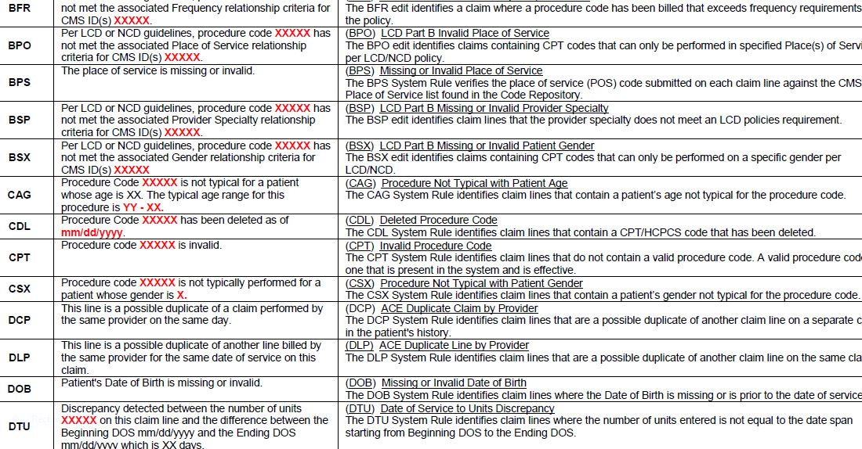
ACE Smart Edit Listing
https://www.palmettogba.com/Palmetto/Providers.Nsf/files/EDI_277CA_Smart_Edits.pdf/$File/EDI_277CA_Smart_Edits.pdf

Slide 67
Comparative Billing Reports
What is a comparative billing report (CBR)?
CBRs are reports that show providers how they rank against their peers in the state and nationally in billing for certain risk areas
This report does not contain patient specific data
The CBR applies to all provider types
The CBR is not intended to be punitive or sent as an indication of fraud, it is intended to be proactive statements that will help the provider identify potential errors in their billing practice

Slide 68
Modifier Lookup Tool

Slide 69
Local Coverage Determinations (LCDs)

Slide 70
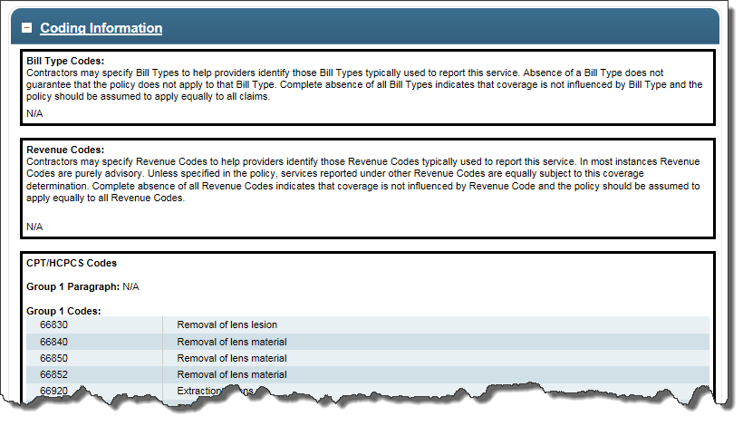
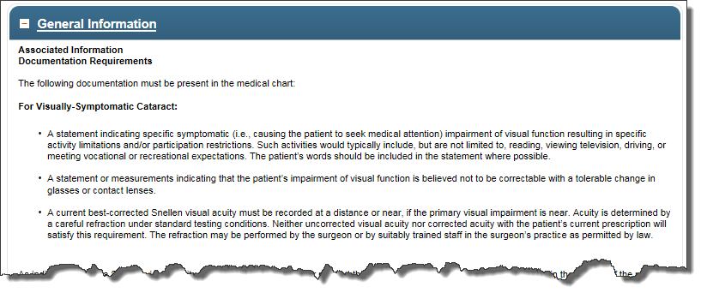
LCD Breakdown

Slide 71
PWK
PWK can be used for those situations where Medicare typically asks for additional documentation to complete claim processing
Procedure Codes That Require Additional Documentation Article
https://www.palmettogba.com/Palmetto/Providers.nsf/DocsR/JJ%20Part%20B~Browse%20by%20Topic~General~Procedure%20Codes%20that%20Require%20Additional%20Documentation?open&Expand=1
PWK documentation should be submitted for the Current Procedural Terminology (CPT) and Healthcare Common Procedure Coding System (HCPCS) codes listed in the additional documentation article or for claims that include the specified modifiers
Submitting Additional Documentation Article (when required for claims adjudication)
https://www.palmettogba.com/palmetto/providers.nsf/DocsR/JJ-Part-B~AW8L9W7863

Slide 72
Locating the PWK Fax Coversheet
PWK cover sheet is located on the Palmetto GBA website under the Forms/Tools tab on the top tool bar
Select Medicare Forms
Select Claims
Select answers to a series of questions
Complete all the fields on the form

Slide 73
Part B Provider Contact Centers
Jurisdiction J
8:00 am - 6:00 pm, ET
877-567-7271
The Interactive Voice Response (IVR) Hours of Availability – 24 hours a day, 7 days a week
Except dark days
IVR Job Aids available

Slide 74
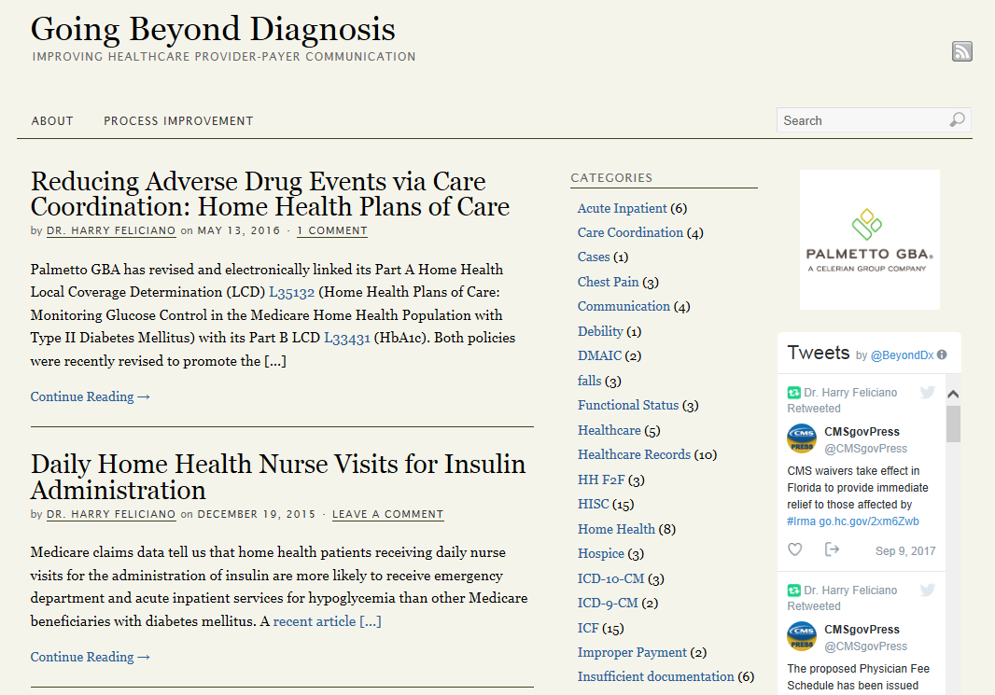
Social Media
Twitter Handles
@PalmettoGBA
@PalmettoGBA_JJA
@PalmettoGBA_JJB
@BeyondDX
YouTube Channels
Palmetto GBA, PalmettoGBAEdu
LinkedIn
Facebook
@PalmettoGBA, LLC
Blogs
Going Beyond Diagnosis

Slide 75
Questions & Open Discussion

